Slide 1
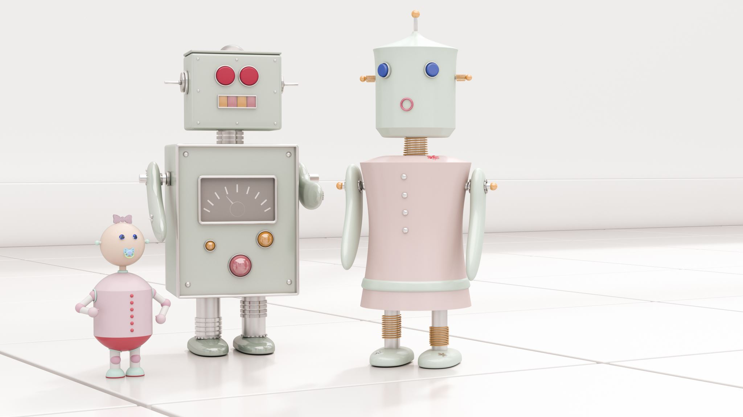
Spatial Hearing fNIRS Update 7-28-2023
Benjamin Richardson

Slide 2
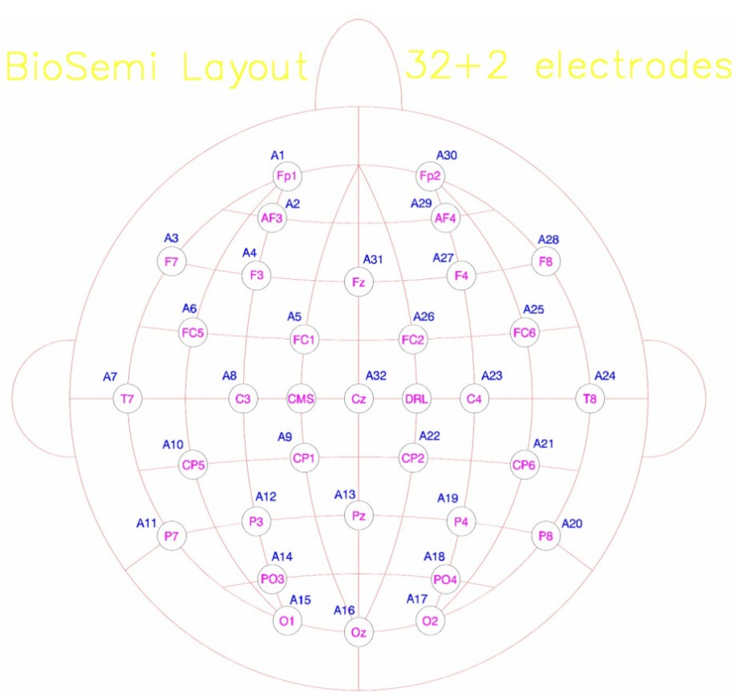
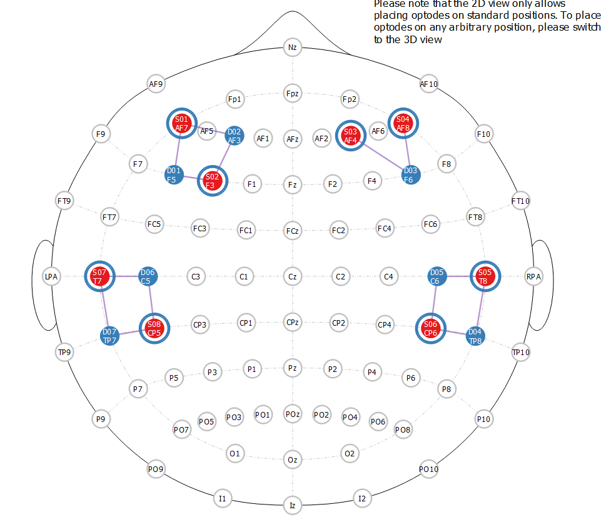
Montage

Slide 3
50 uS ITD
500 uS ITD
10 dB ILD
Smallest STG Lateralization Largest DLPFC response | Largest STG Lateralization Small DLPFC response | Largest STG Lateralization Small DLPFC response
Small STG lateralization Large DLPFC response | Large STG Lateralization Smallest DLPFC response | Large STG Lateralization Smallest DLPFC response
Speech masker
Noise masker
Random onset/delay timing
Broadband sounds only
Counterbalanced attend left/attend right (tone cue)

Slide 4
A raw look of breakdown by subject – all conditions hbo same color = same channel

Slide 5
Individual subs cont.

Slide 9
Hmm…thinky thinky
Ben is withdrawing making conclusions until more subjects
Responses in right DLPFC seem to match hypothesis across spatial cues
In Right STG?? Not so much…but this seems to be driven by a single subject with a hyperactive right STG
Cortical blood stealing, my arch nemesis, is present methinks
I need to read/write on this. Will most likely be a hot topic in upcoming manuscript

